Slide 1


Cloud-Connected Automated Guided Vehicle
Supervised by
Prof. Dr. Mohamed Watheq El-Kharashi - Dr. Mohamed Abdelsalam
Presented by
Sara Akmal Mohamed 17P6015 Mariam Salah Taha 17P6033 Fatema Hassan Aman 17P3060 Islam Ashraf Azab 17P6086 Yusuf Amr Nabil 17P6052 Omar Hassan ElKotb 17P6080

Slide 2
Contents
Overview
User Configurator
Docker’ized Private Cloud
Dashboard
AI Services
Database
Cloud-Connect Gateway
Robot Operating System (ROS) Subsystem
Future Work
Demo

Slide 3
Overview

Slide 4
Goal
Designing and implementing a generic tool
The tool helps users with their own ROS subsystem
Monitor the sensors’ data of the robot in real-time
Have a database with these data stored
Monitor the streaming of the robot
Control the movement of the robot
Use AI services

Slide 5
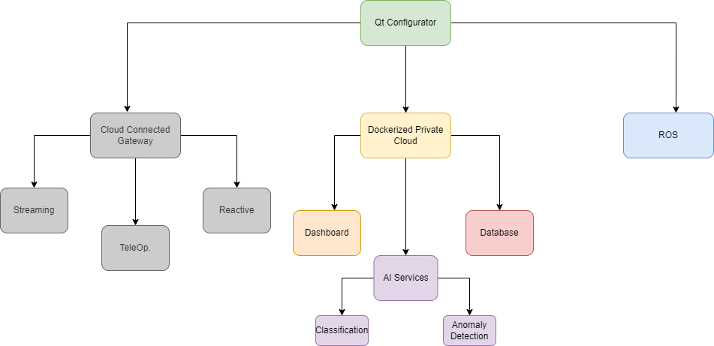
Design Architecture Diagram

Slide 6

Why Private Cloud?
Security and Privacy
Flexibility
Scalability
Performance

Slide 7



Frameworks & Tools Used
Docker
Django
ROS
Qt Designer

Slide 8
First Milestone Summary
Configurator UI Initial Design
Integration between Configurator and Dashboard
Real-time
Historical
Learning ROS

Slide 9
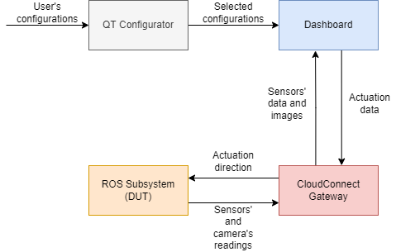
System Block Diagram

Slide 10
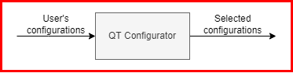
User Configurator

Slide 11
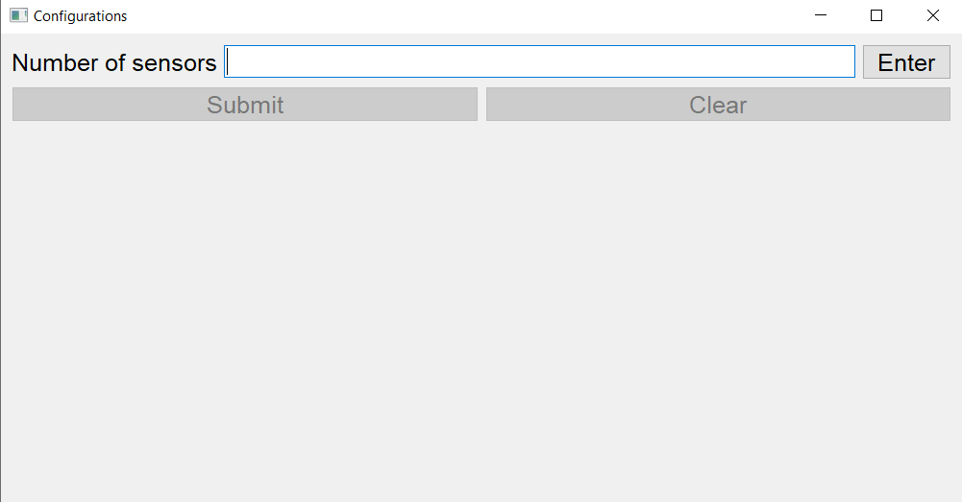
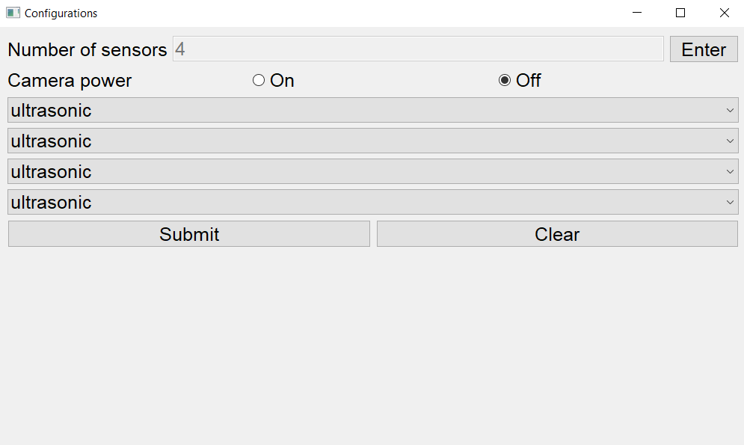
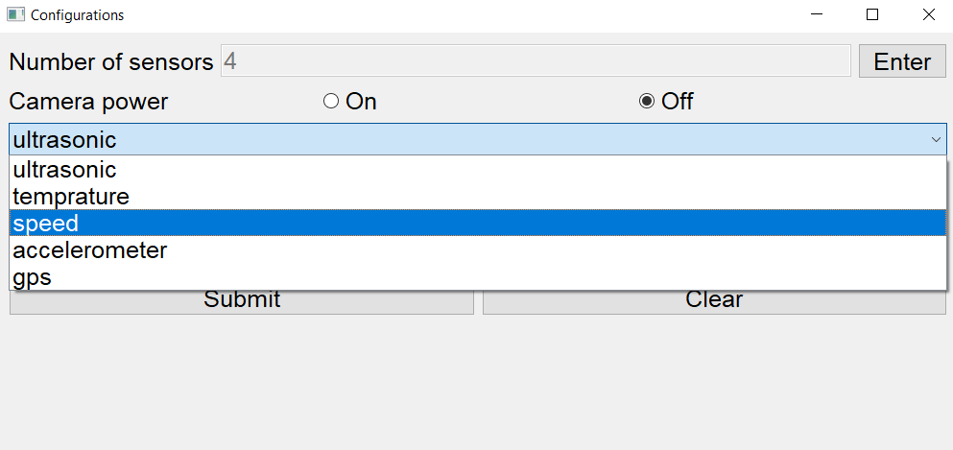
Initial Configurator UI
Start Page
Enter Button Pressed
Choosing Sensor Type

Slide 12
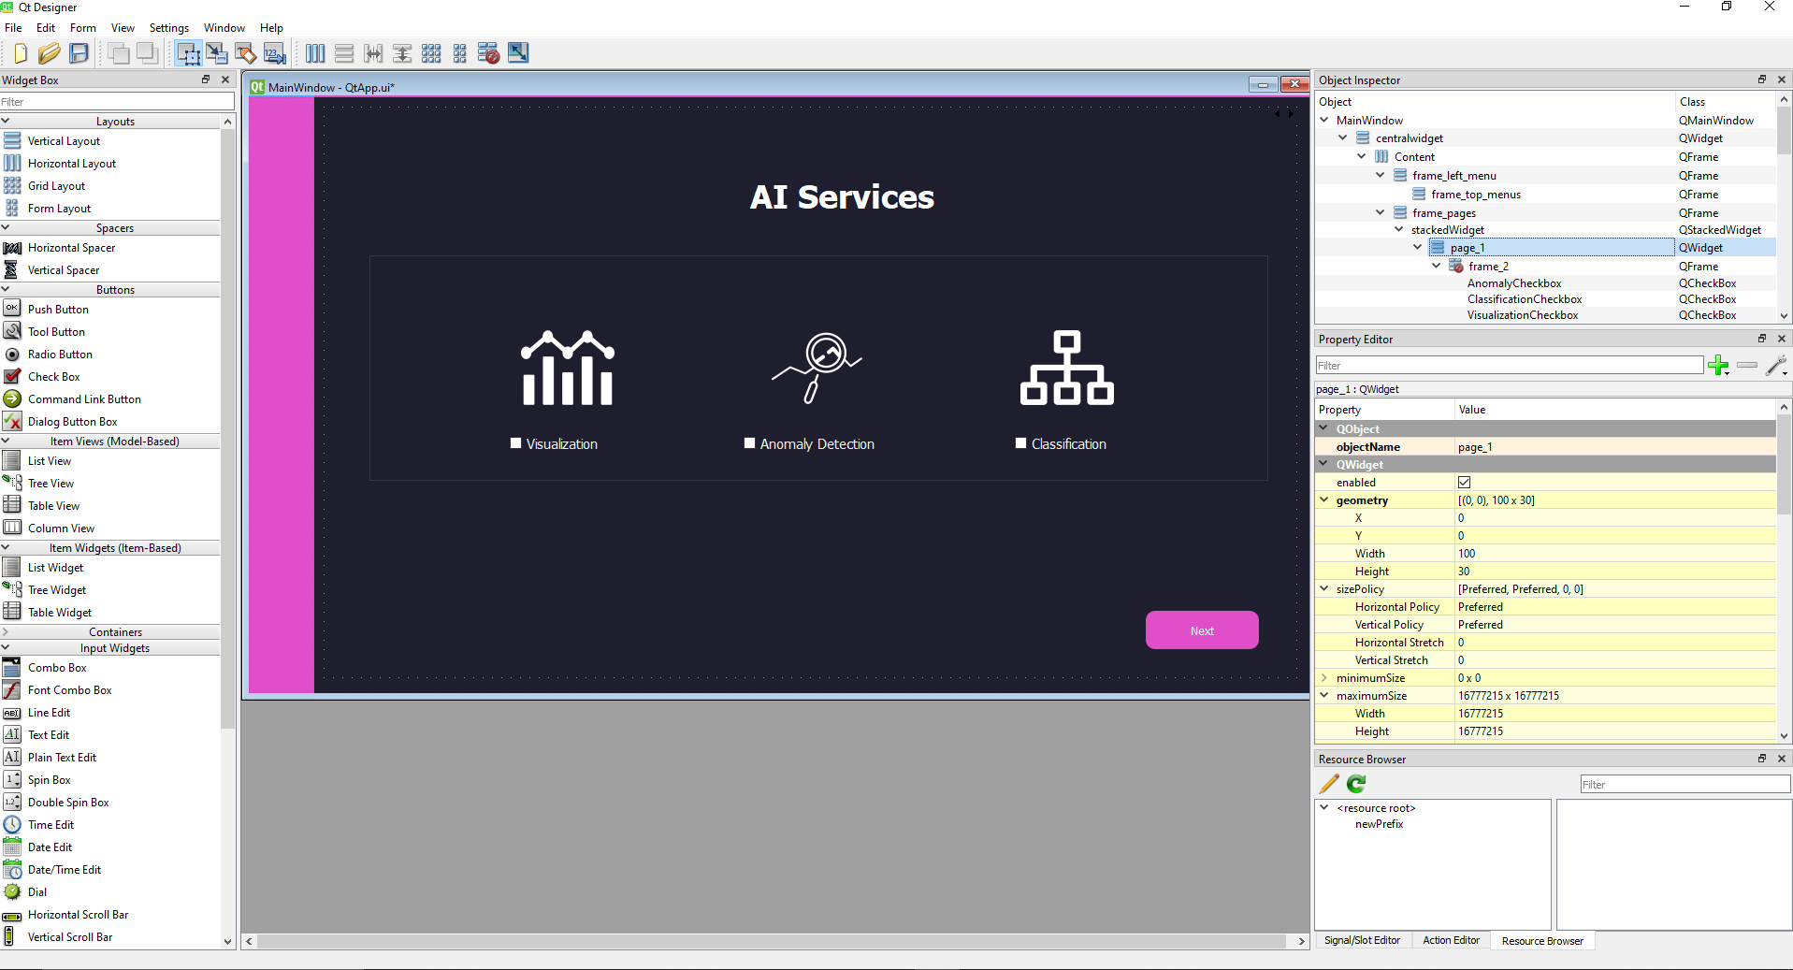
Qt Designer Tool

Slide 13
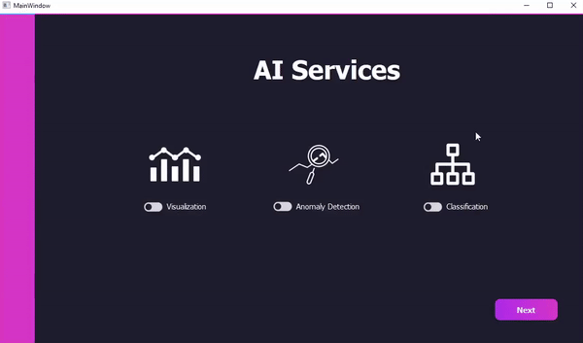
Entry Scene

Slide 14
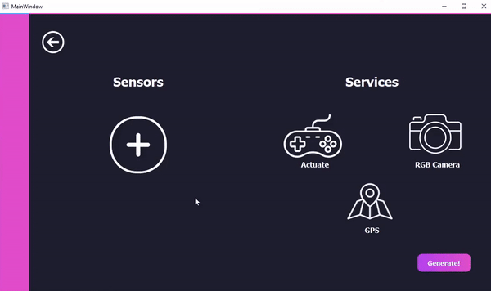
Sensors & Services Scene - 1

Slide 15
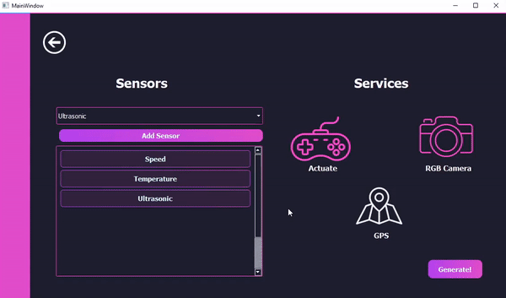
Sensors & Services Scene - 2

Slide 16
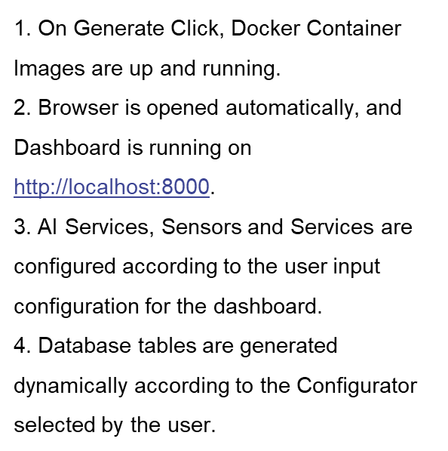
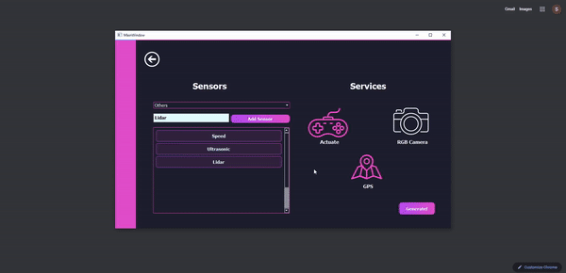
Automation

Slide 17
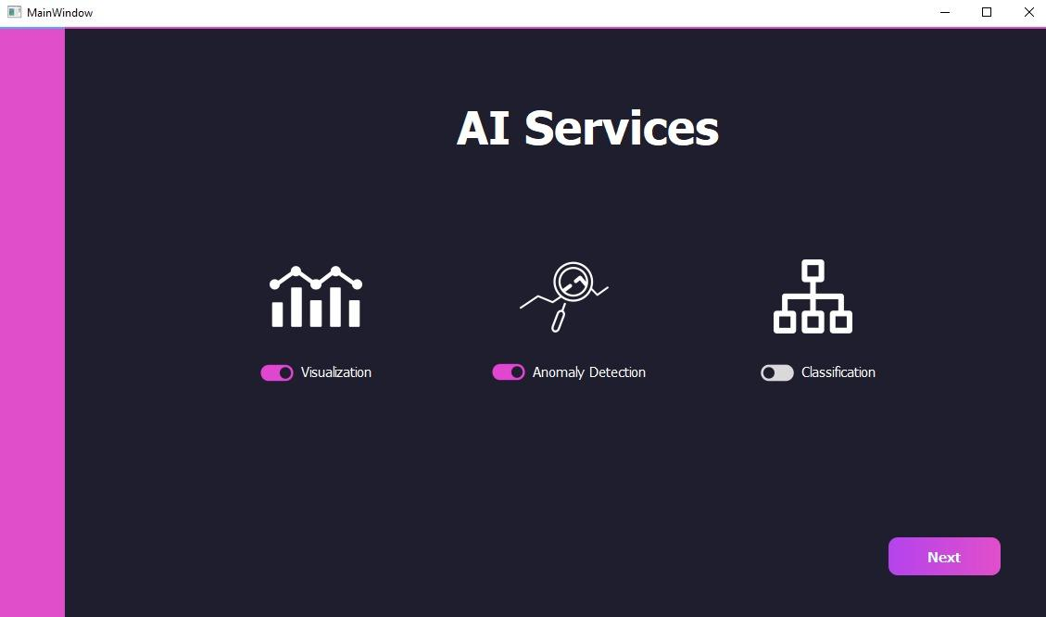
Visualizing Example
Selecting Anomaly Detection AI Service from the Entry Scene

Slide 18
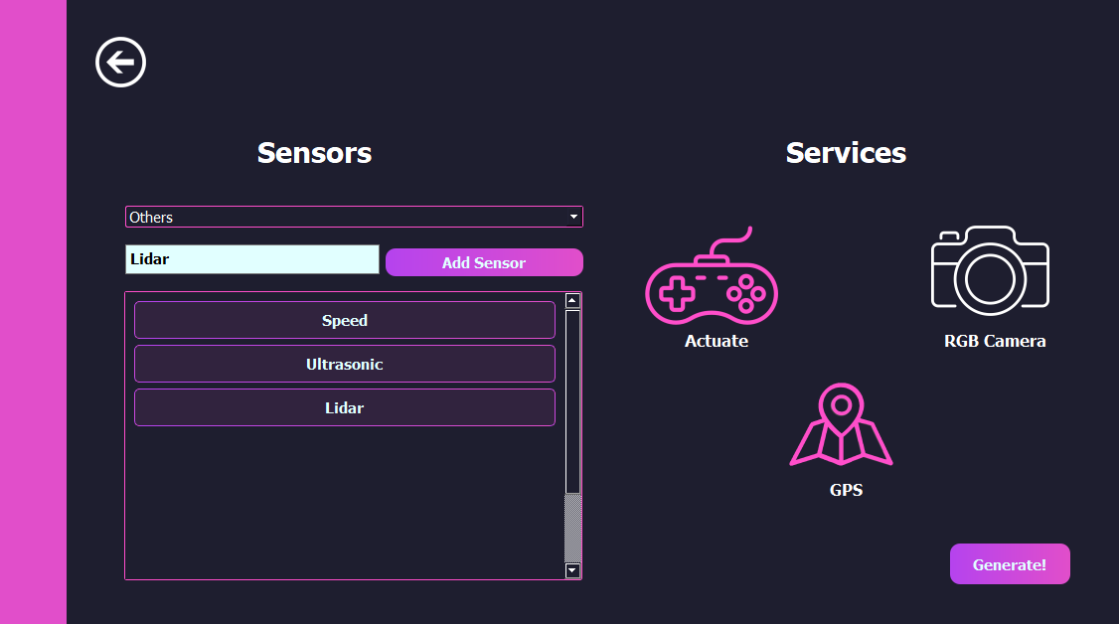
Visualizing Example (cont.)
Selecting Speed, Ultrasonic from default sensors and adding Lidar from user input
Selecting Actuate and GPS Services

Slide 19
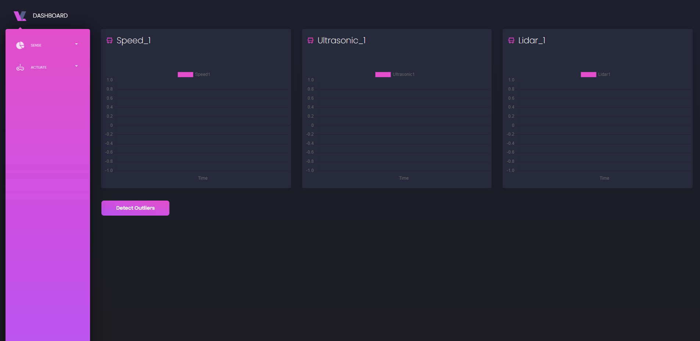
Visualizing Example (cont.)
Dashboard Sensors as configured, Speed, Ultrasonic and Lidar
Detect Outliers feature button according to the AI Service configured, Anomaly Detection

Slide 20
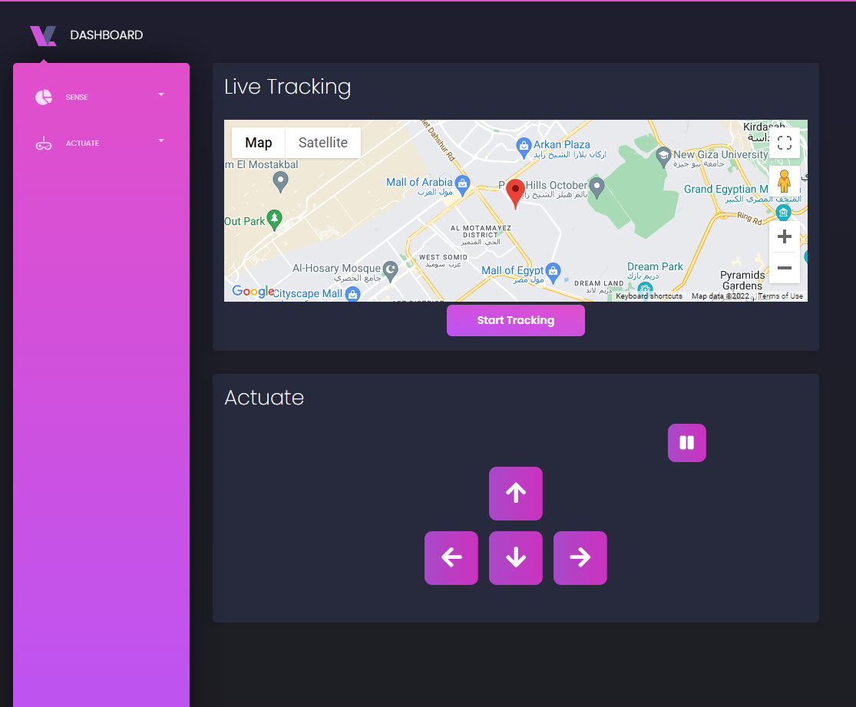
Visualizing Example (cont.)
Dashboard Services as configured, GPS and Actuate

Slide 21
Docker’ized Private Cloud

Slide 22
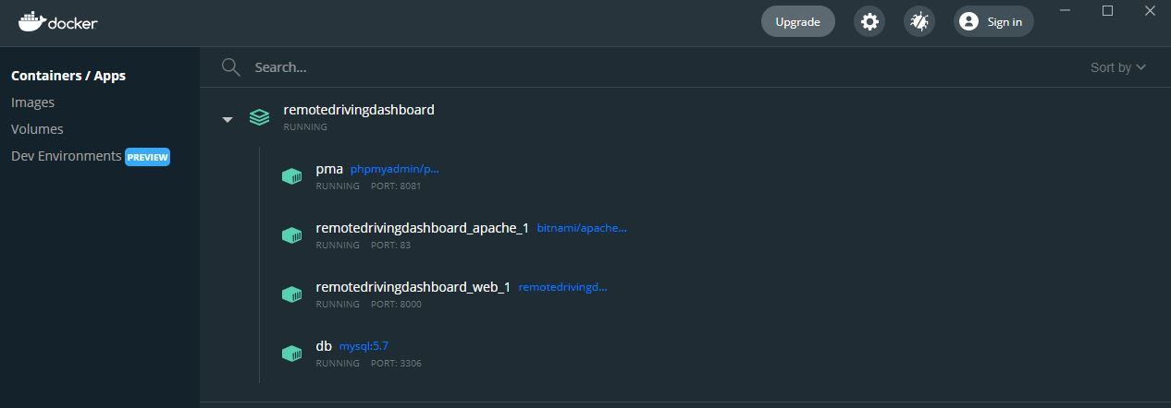
Dockeri’zed Private Cloud
Docker container has images of the Web Application and Database
Container running on our local network

Slide 23
AI Services

Slide 24
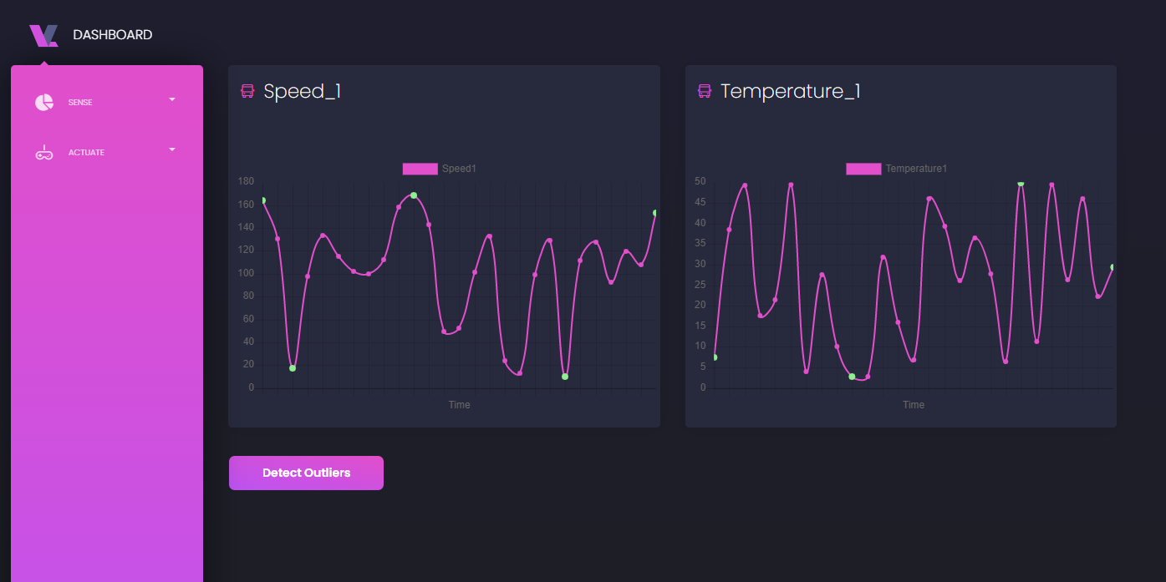
Anomaly Detection
Outliers are detected using the Interquartile Range Method
IQR is calculated from the difference of the 1st & 3rd quartiles.
The cut-off upper and lower limits are calculated by a selected factor k = 1.5

Slide 25
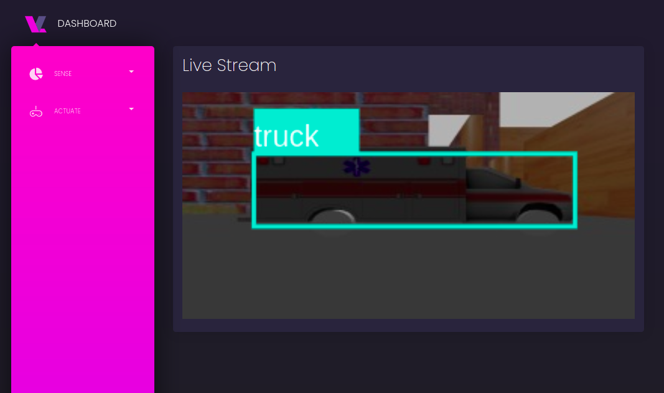
Classification
Classification is one of AI services that is implemented in our Dashboard
We use MS COCO (Microsoft Common Objects in Context)

Slide 26
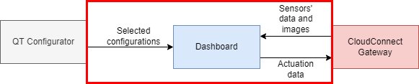
Dashboard

Slide 27
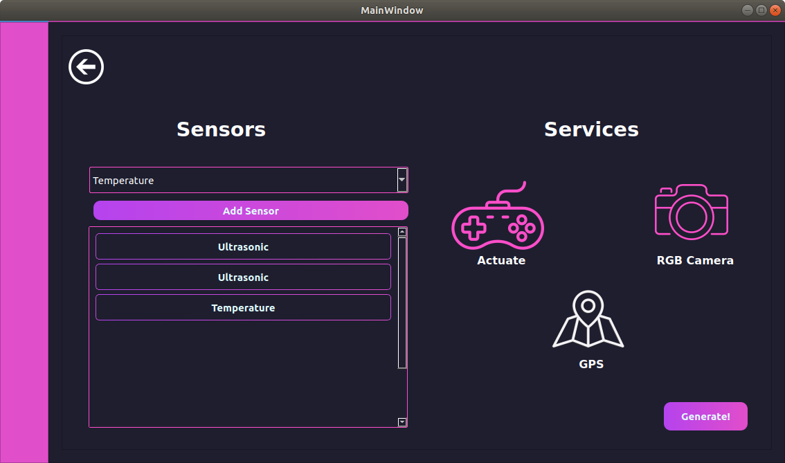
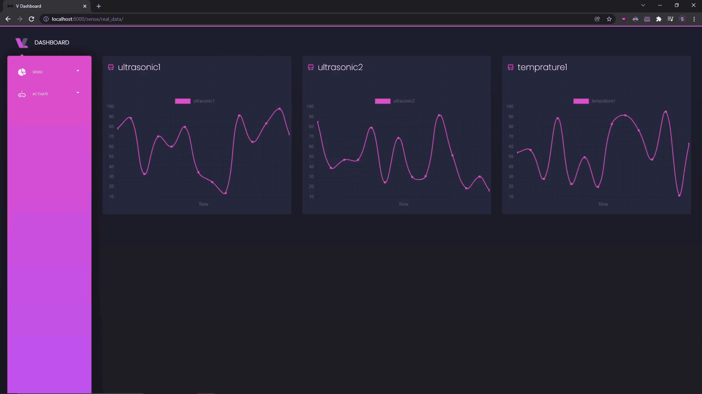
Real-Time Data Visualization
User Input through Qt GUI
Charts created dynamically based on user inputs.
Running a ROS Simulator to generate Random Data.

Slide 28
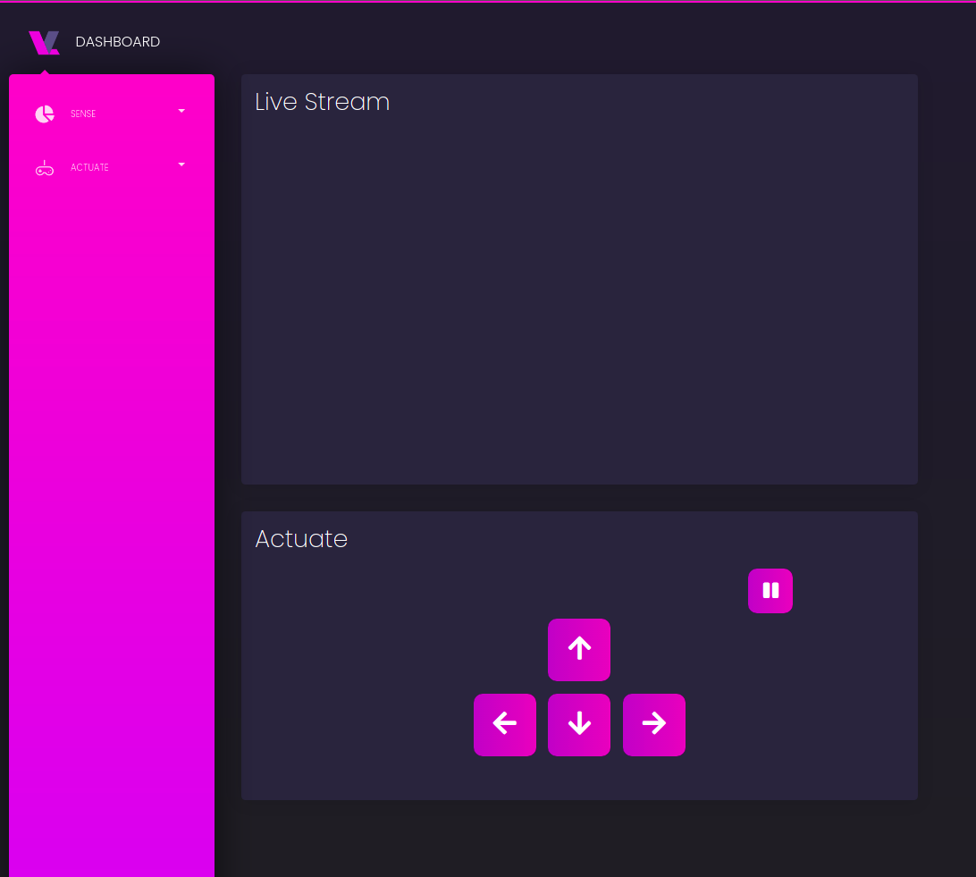
Actuate Visualization
Live Stream to monitor the robot’s camera in realtime.
Actuate buttons are used to control the robot’s movement.

Slide 29
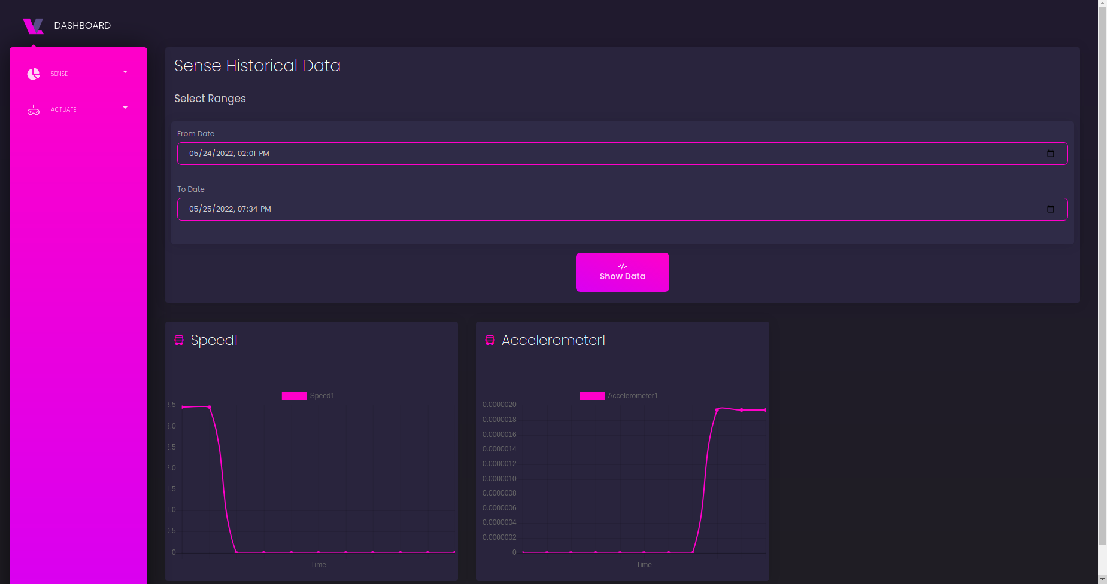
Historical Data Visualization
Charts are updated based on the Qt configurations.
Sensors Table is generated based on Qt configurations as well.

Slide 30
Database

Slide 31
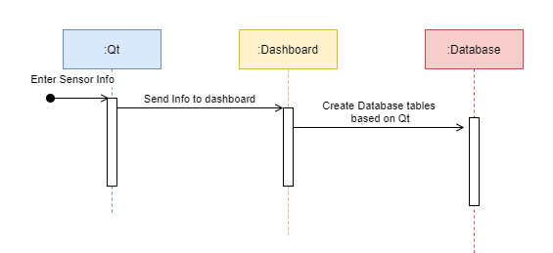
Initialization Sequence Diagram

Slide 32
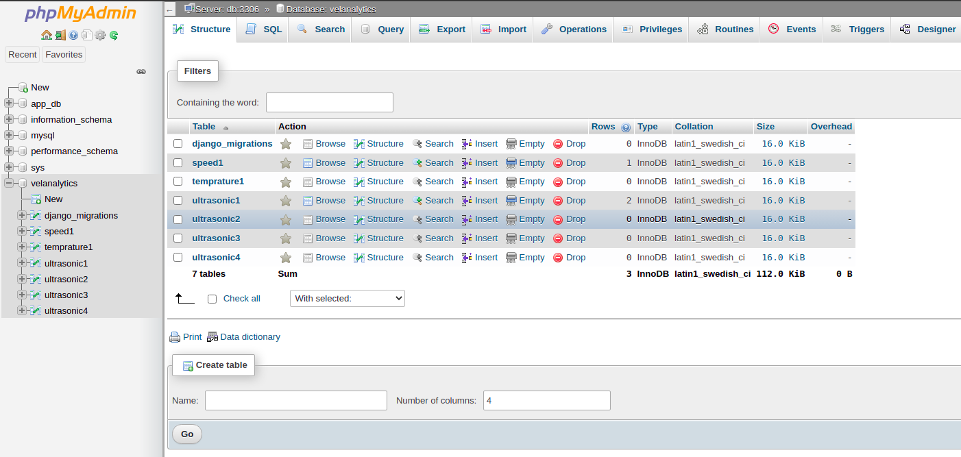
Database Visualization
Database is generated dynamically based on Qt configurator.
It contains a table for each configured sensor.

Slide 33
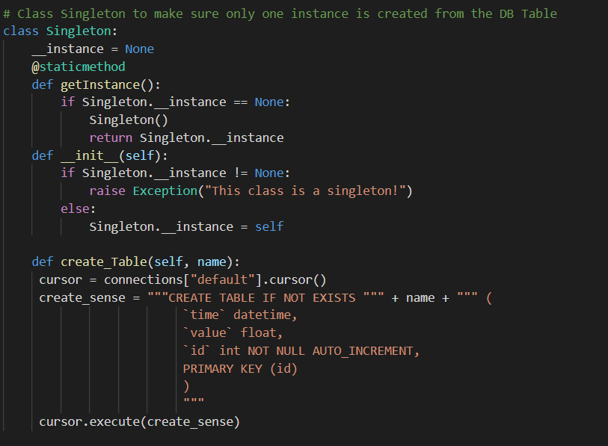
Database Singleton Creation
Database is generated dynamically based on Qt configurator.
It contains a table for each configured sensor.

Slide 34
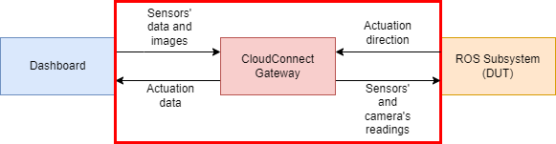
CloudConnect
Gateway

Slide 35
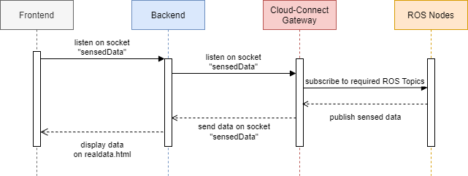
Real-Time Sequence Diagram

Slide 36
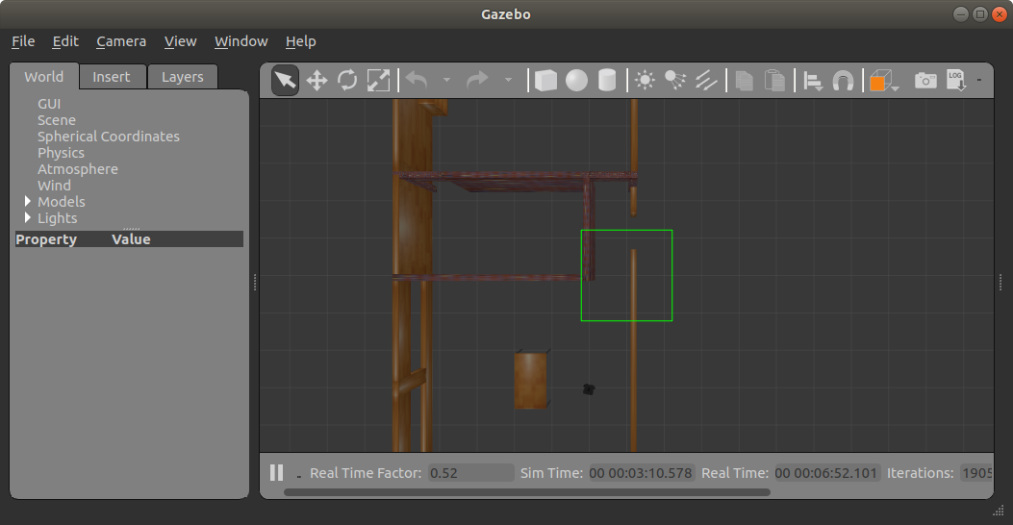
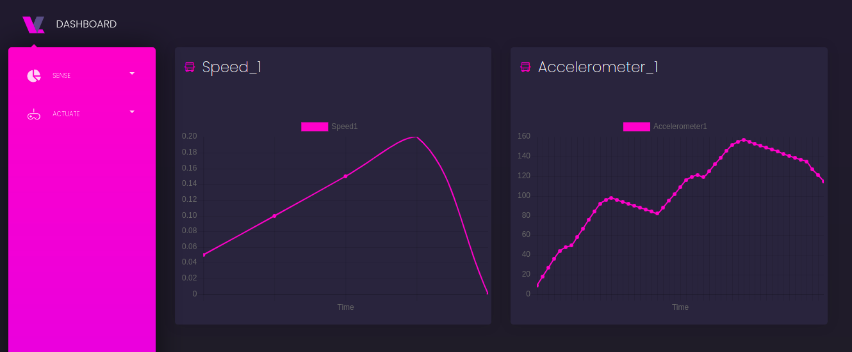
Reactive Gateway
Listen on socket to receive data from sensors
Processing data then send it to dashboard to display it to user

Slide 37
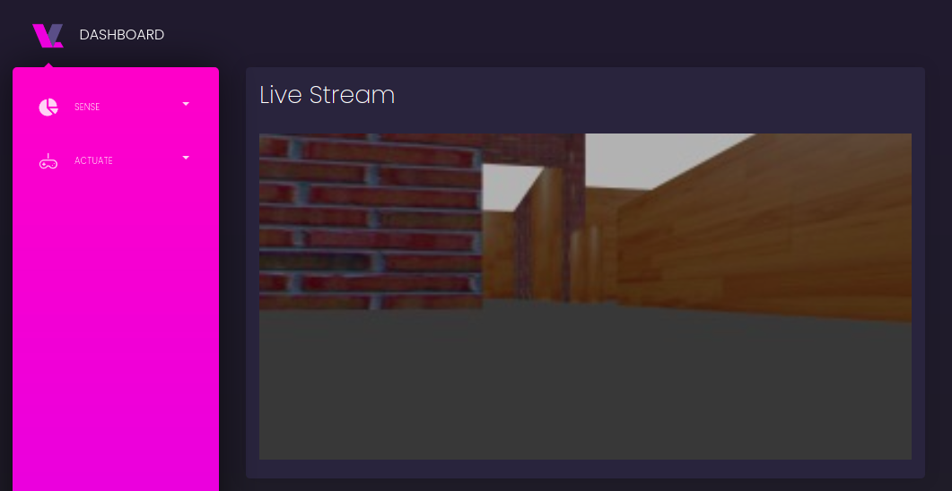
Stream Gateway
Listen on socket to receive image from robot camera

Slide 38
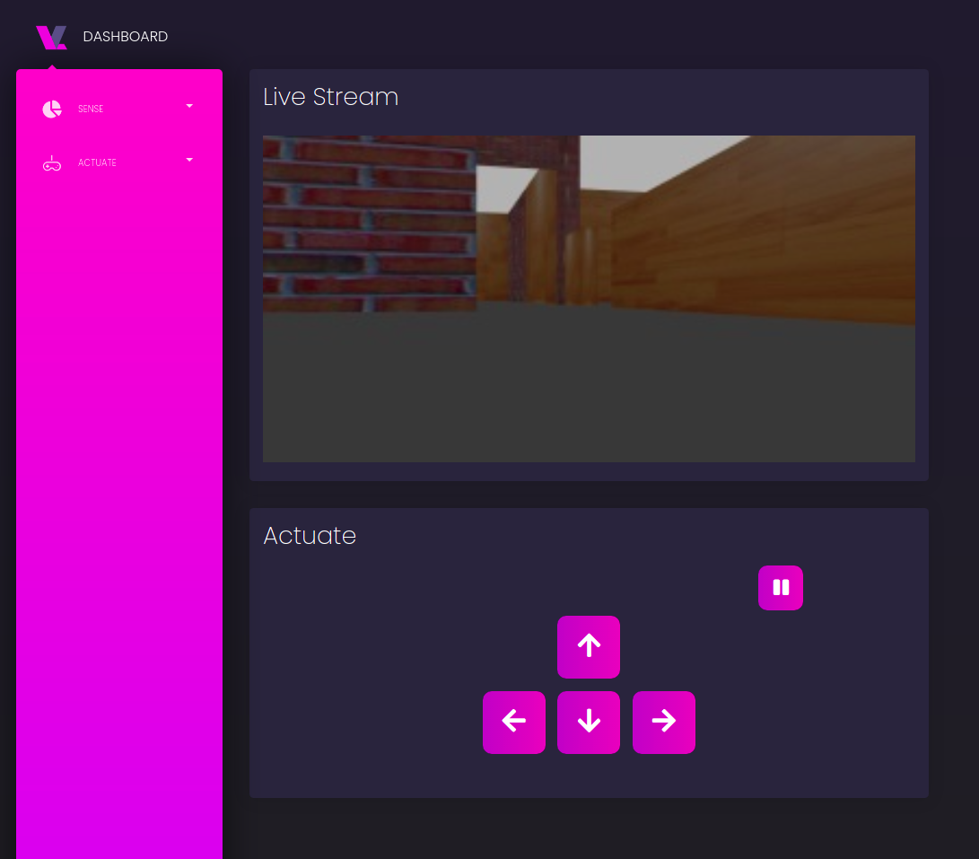
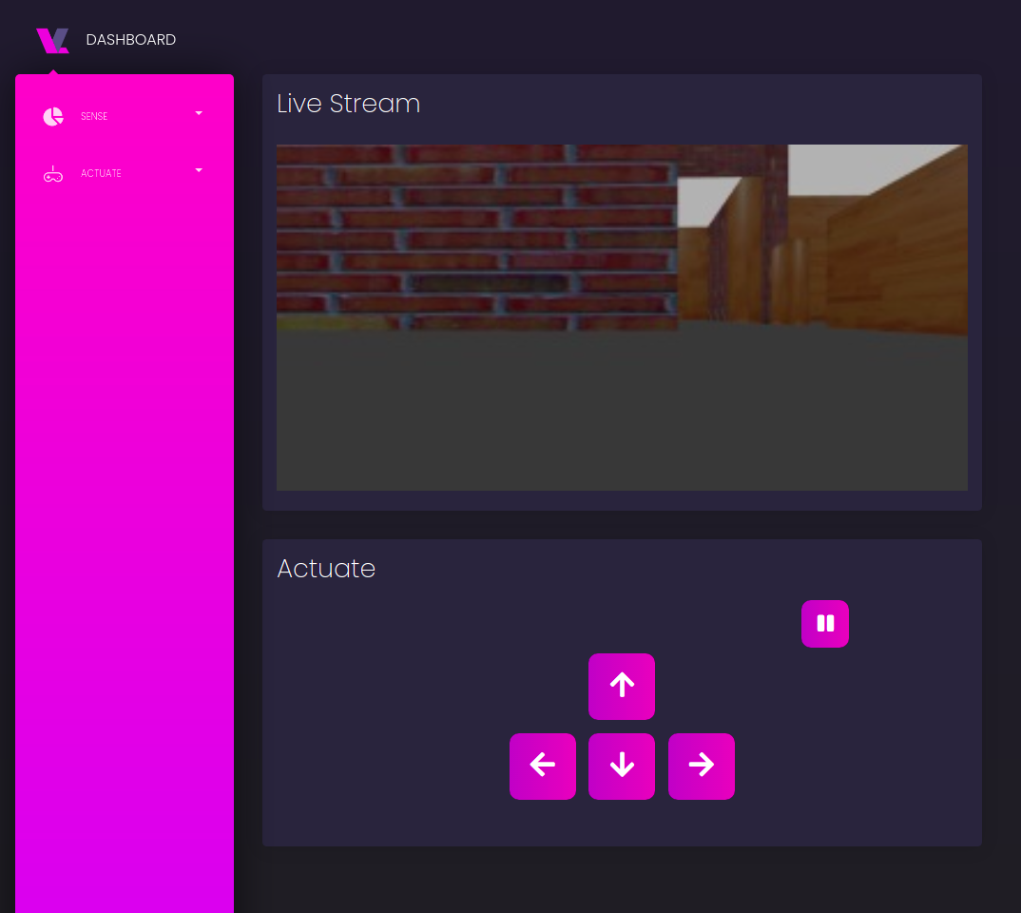
Teleop Node Gateway
Sending user controls through a socket to ROS so robot can act on it
In this figure user change direction of robot

Slide 39
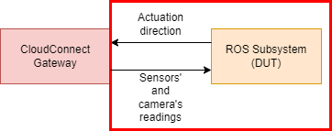
ROS Subsystem (DUT)

Slide 40
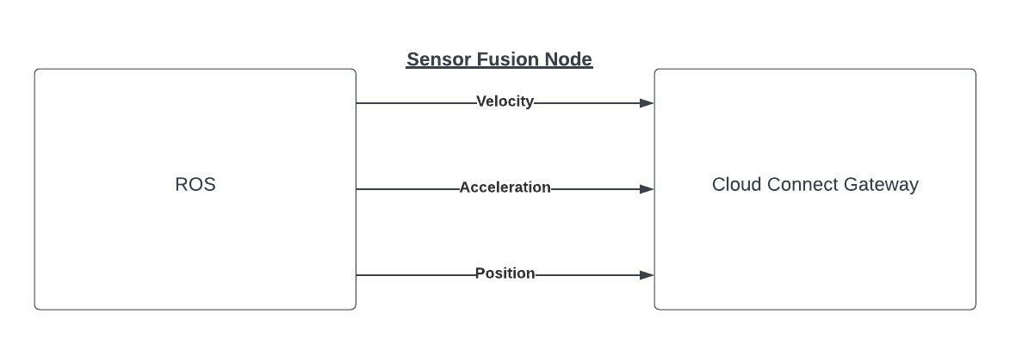
Sensor Fusion Node

Slide 41
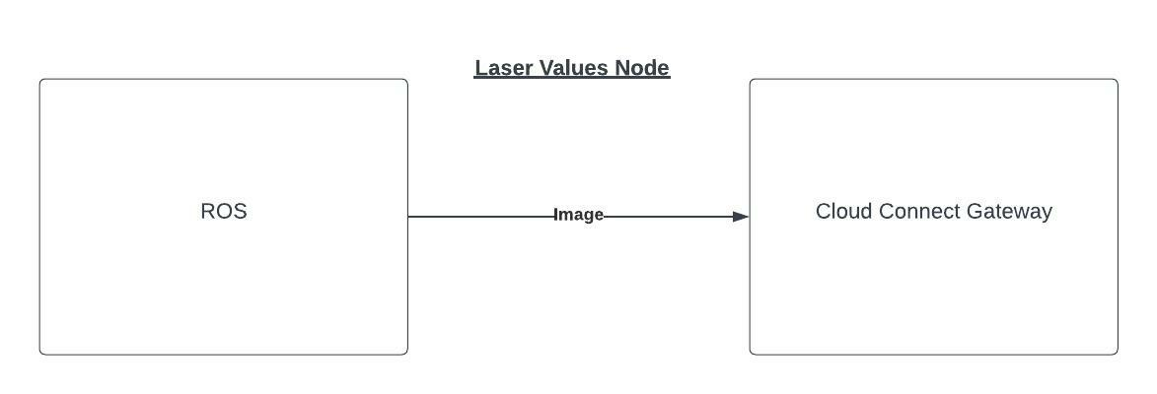
Laser Values Node

Slide 42
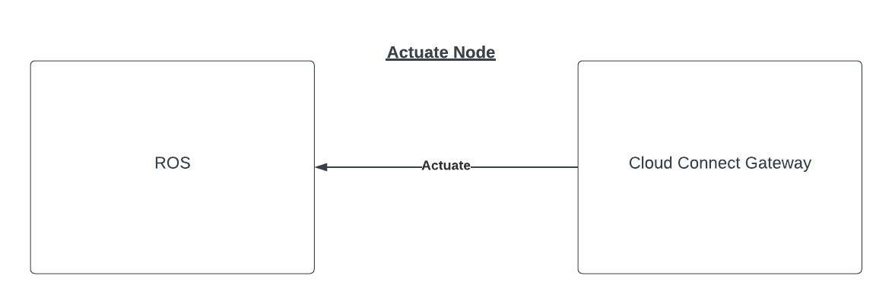
Actuate Node

Slide 43
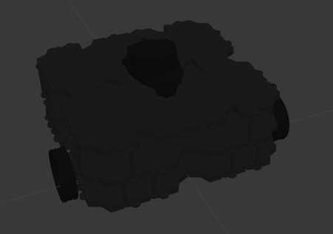
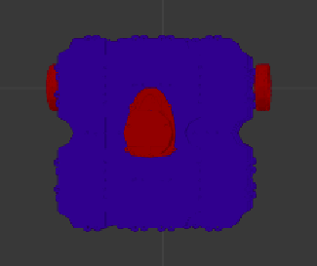
Customize Robot
File that contains the design of the robot:
~/catkin_ws/src/ROS/turtlebot3_simulations/turtlebot3_description/urdf/turtlebot3_waffle_pi.gazebo.xacro

Slide 44
Future Work

Slide 45
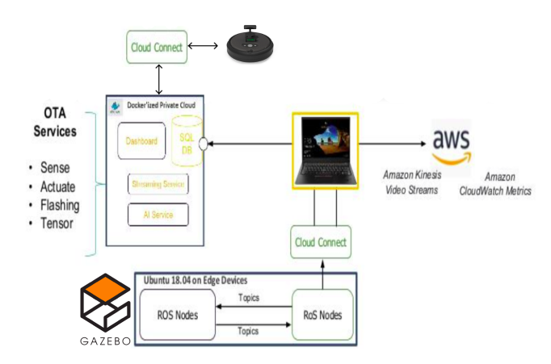
Digital Twin of Automated Guided Vehicle
Notes:
The Concept of Digital Twin is to simulate the physical environment to the simulation using gazebo and the real turtlebot
(like metaverse)

Slide 46
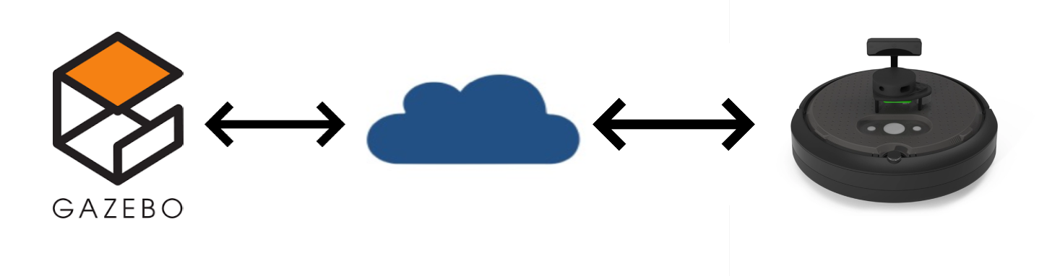
Digital Twin of Automated Guided Vehicle
Notes:
The Concept of Digital Twin is to simulate the physical environment to the simulation using gazebo and the real turtlebot
(like metaverse)

Slide 47
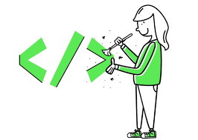



JavaScript Framework
Refactoring the Frontend using a JS Framework
ReactJS
Angular
Vue JS

Slide 48
Demo

Slide 49
Questions?

Slide 50
Thank you!

